Slide 1
Agriculture Monitoring Robot
Guide:
Prof.Neeba Sabu
Dr.Arya Nandini
Members:
Anusha K K (17)
Haridev V S (32)
Heera N (35)
Sanu Stephen (54)

Slide 2
General Outline
Our project aims to continuously monitor agricultural field to provide an efficient way to control various parameters.
IoT Technology can help in collecting information about conditions like soil moisture, weather, temperature, sunlight etc.

Slide 3
General Outline
Wireless sensor networks can be used for monitoring the farm conditions and micro controllers can be used to control and automate the farm processes.
The main focus is to reduce the human effort and resources which can enhance the yield.

Slide 4
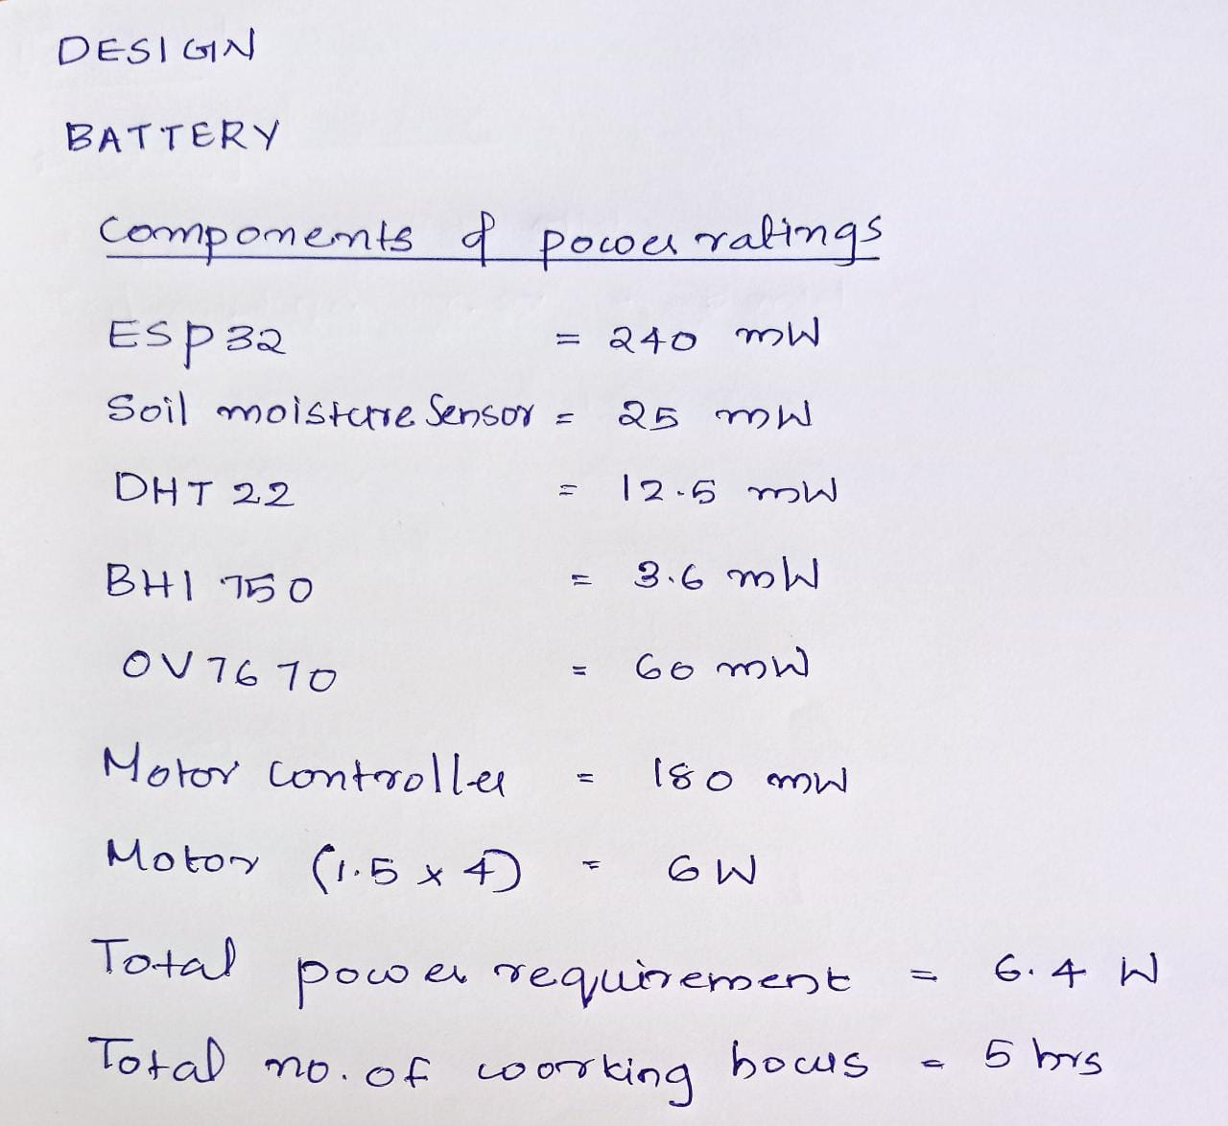
Design
Battery Design

Slide 5
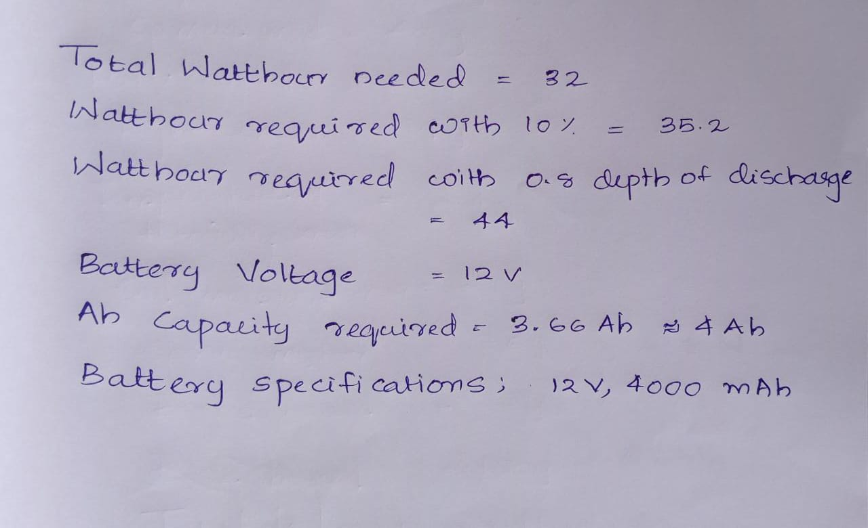

Slide 6
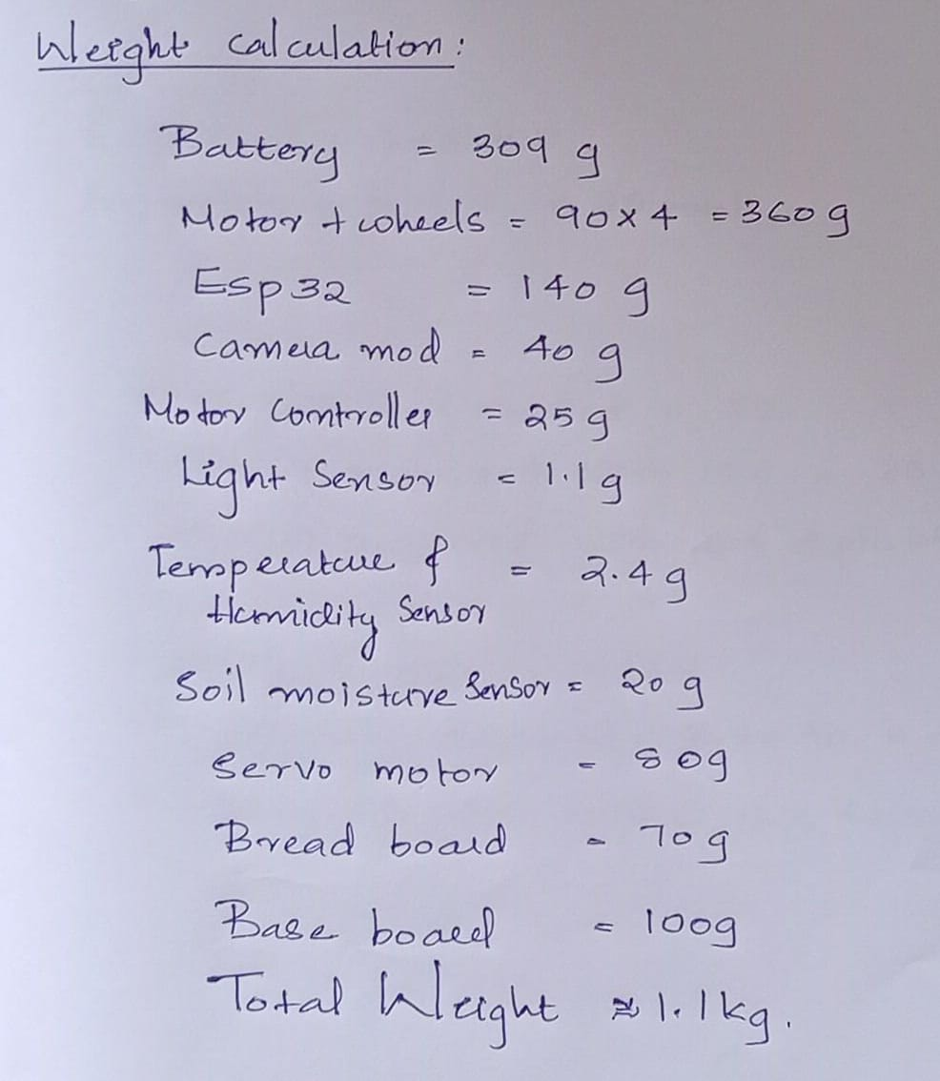
Motor design

Slide 7
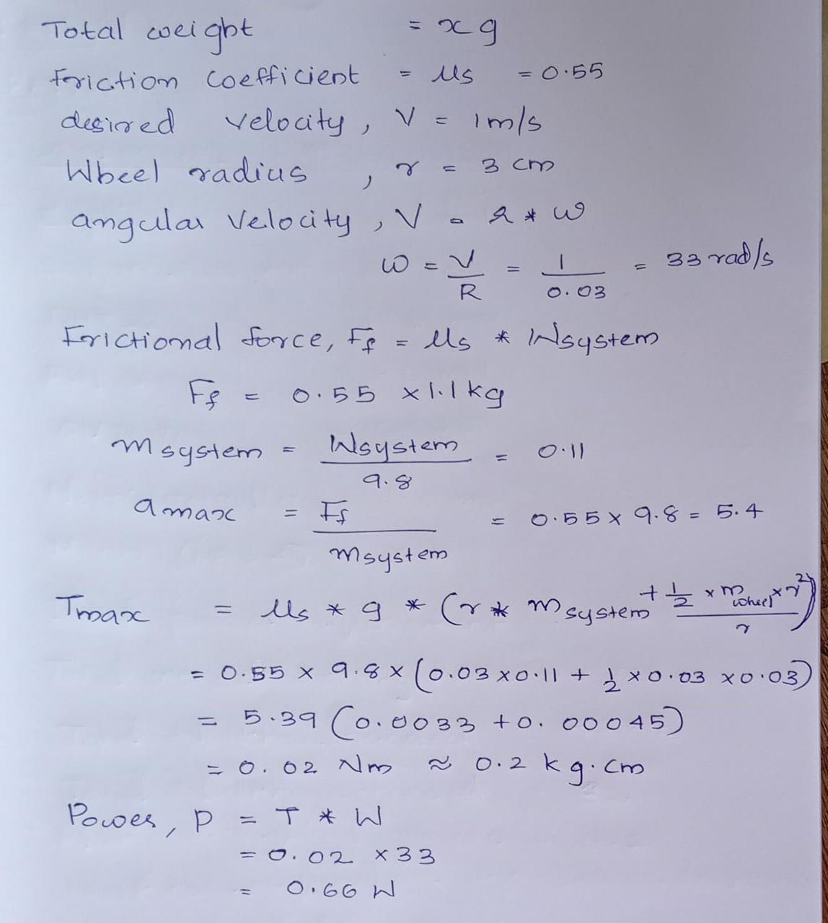
Motor design (….)

Slide 8
Motor design (….)

Slide 9
Blynk-interface
Created Project dashboard and arranged buttons, slides, and other widgets onto the screen.
Created live streaming window and buttons for driving the robot.

Slide 10
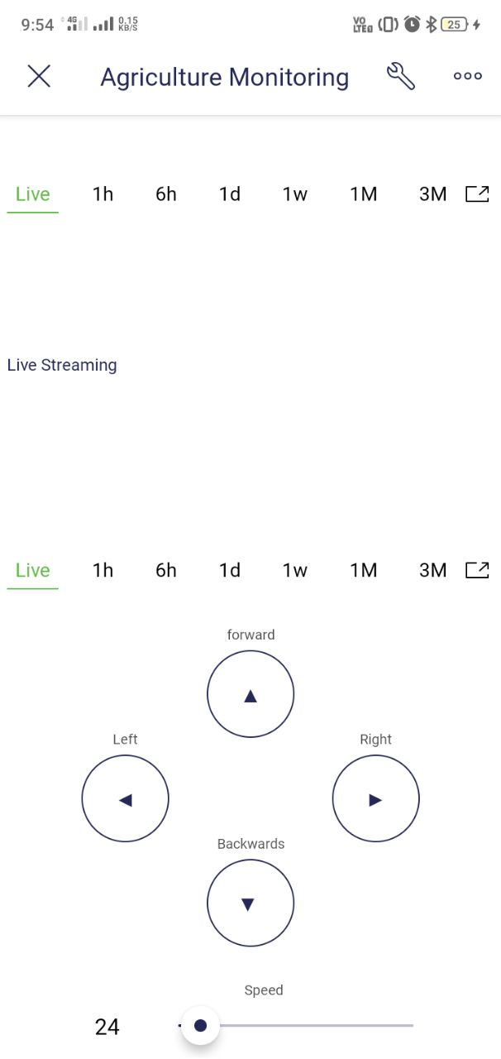
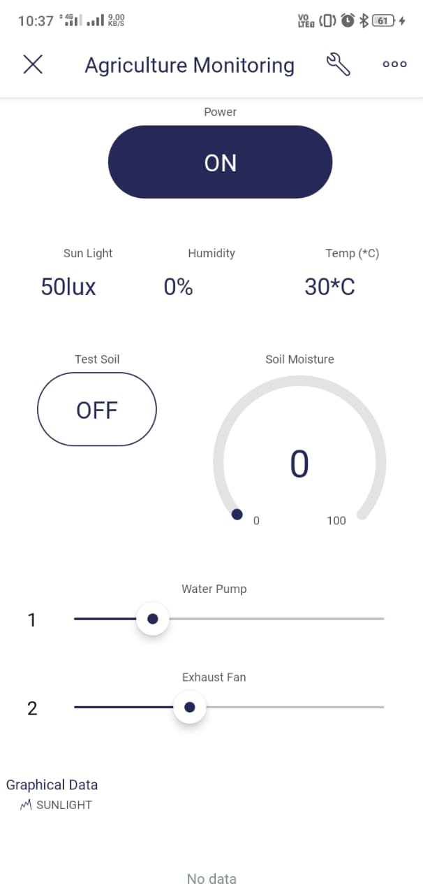

Slide 11
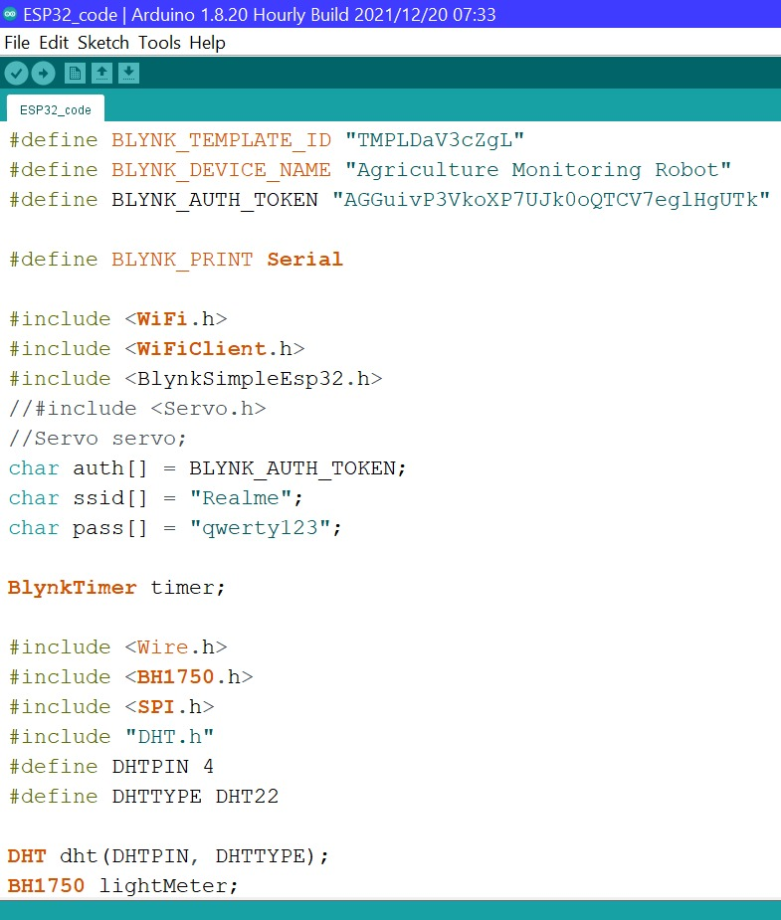
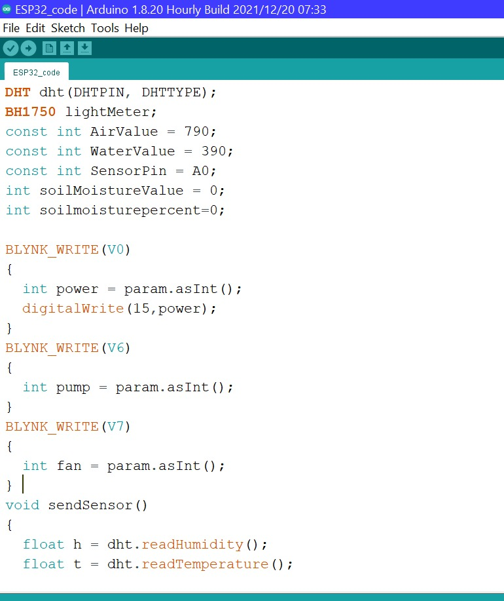
Program

Slide 12
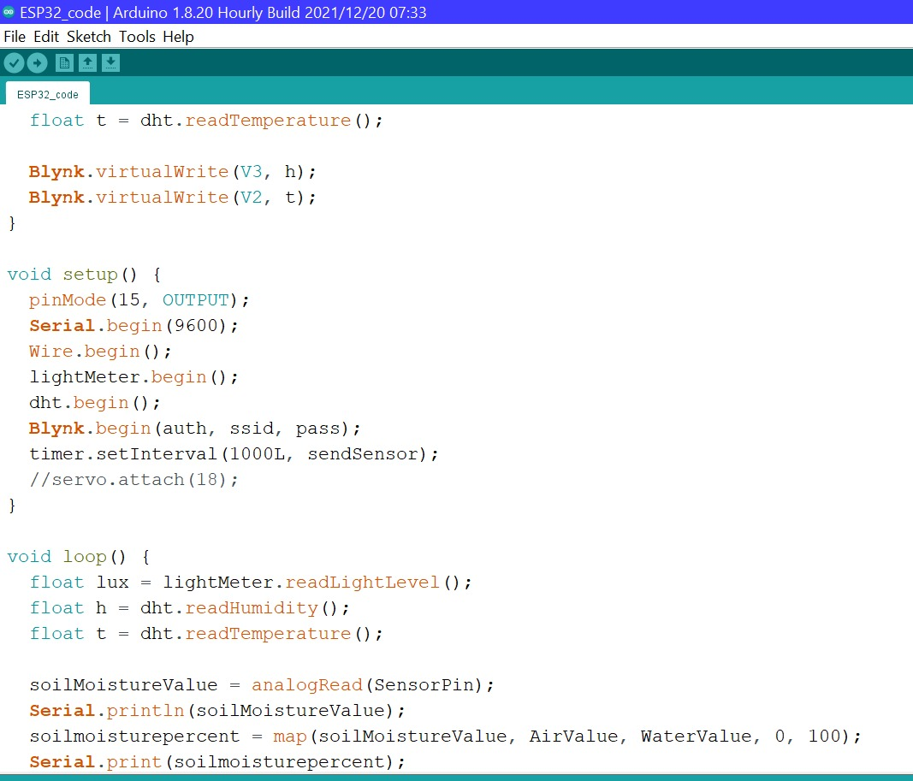
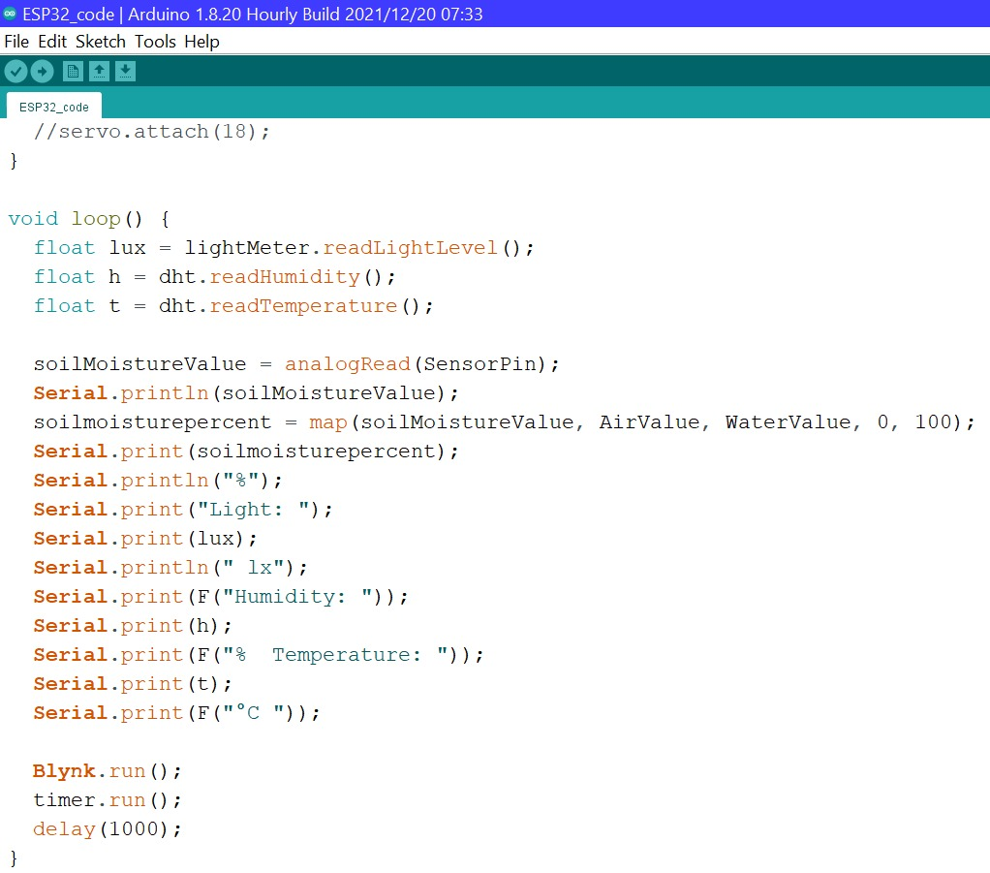
Program

Slide 13
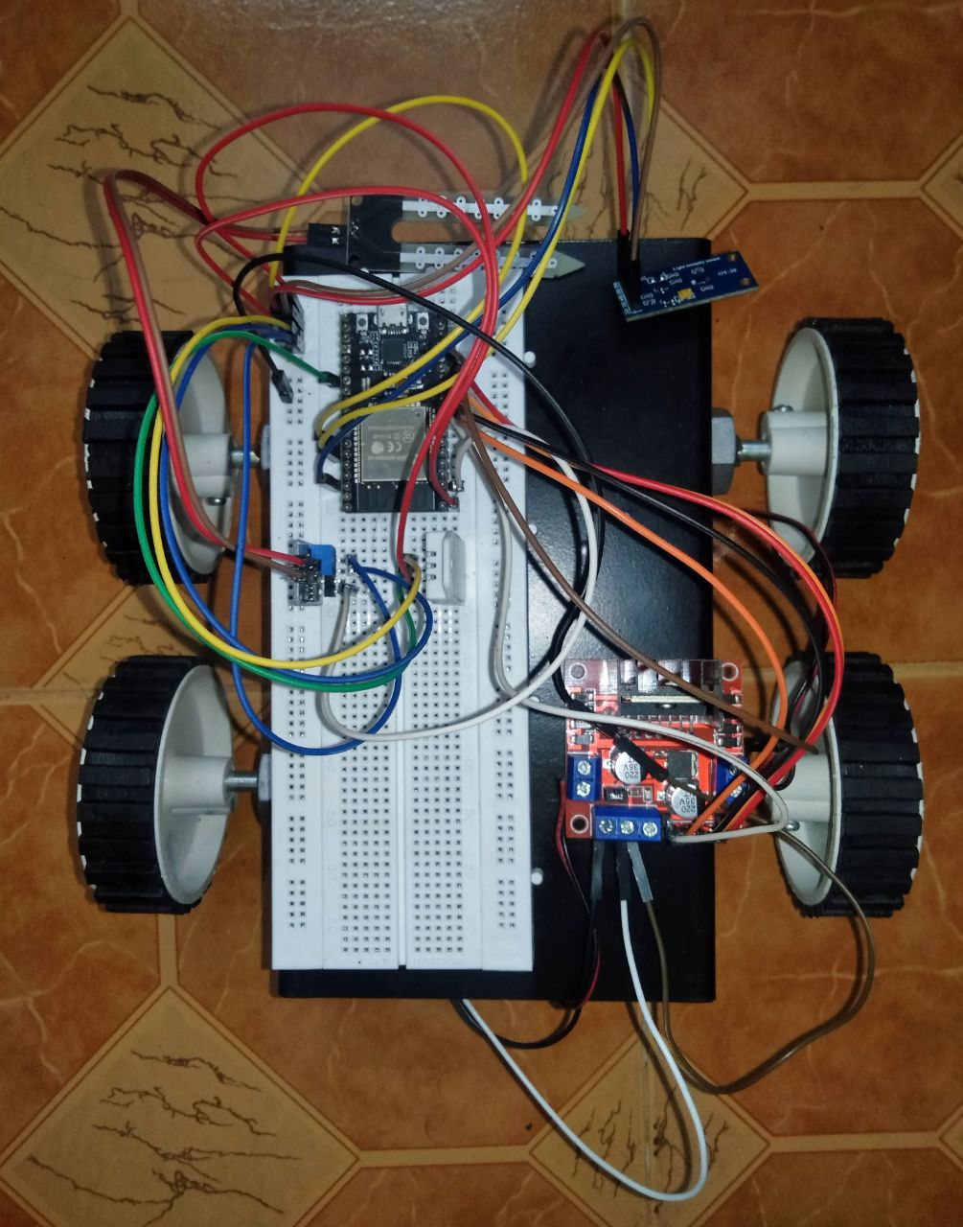
Hardware Implementations

Slide 14
Timeline of Progress

Slide 15
Upcoming Objectives
Construction of robotic arm for soil moisture measurement.
Implementation of camera module.
Implementaion of April tag for area indentification.
Setting up wireless control of water pump for irrigation system and speed control of exhaust fan.

Slide 16
THANK YOU

